Slide 1

Macro Mod Analytics · Europe + USA · edition 1
Connecting data.
Creating insight.
One macro suite from the Eurostat catalogue to Semafor, MADS scenarios and a publication-ready report — 34+1 countries, six languages of control.
Macro Mod Analytics · Connecting data. Creating insight. · 1/45
MMA Suite

Slide 2
02 · Agenda
What we will show — click to jump
Arrows / space = slide. O = map of all slides. F = fullscreen. D = start the 90-second demo.
Macro Mod Analytics · Connecting data. Creating insight. · 2/45
MMA Suite

Slide 3
03 · Hook
Macro data exist. The working flow usually does not.
Classic portal
Eurostat, ECB, OECD, AMECO: excellent sources — but they remain a catalogue, a table or a static dashboard. The analyst still glues Excel together.
Terminal / news flow
Bloomberg and similar tools give market speed. They rarely give a MIP↔macro bridge, Semafor and a reproducible comprehensive report for country X.
MMA
Pipeline: optimise the cube → build the table and chart → read the ready-made indicator set → diagnose the regime → scenario → report / policy brief.
Macro Mod Analytics · Connecting data. Creating insight. · 3/45
MMA Suite

Slide 4
04 · Numbers that stick
The suite in one breath
HR + EN reports and manuals
Manuals and reports in the author’s home language and in universal EN — the same content, two readers.
Offline-first
M3/M4/publications run from a local RDS/CSV. The live API is a refresh, not a condition for the briefing.
Model honesty
Semafor ≠ Commission MIP assessment. MADS ≠ official forecast. Relative ≠ absolute.
Macro Mod Analytics · Connecting data. Creating insight. · 4/45
MMA Suite

Slide 5
05 · Why this is not “another dashboard”
What MMA does differently
Macro Mod Analytics · Connecting data. Creating insight. · 5/45
MMA Suite

Slide 6
06 · Coverage
34+1 countries · Europe and a USA reference
The same working language
EU27, EFTA, part of the Western Balkans and Turkey — plus the USA as a reference economy (FRED/WB routing). HICP is not converted 1:1 into CPI.
Macro Mod Analytics · Connecting data. Creating insight. · 6/45
MMA Suite

Slide 7
07 · Languages
Six languages of control · reports and manuals in two languages
Control layer = 6 languages
The same navigation, localised buttons, help radio and SUITE bar. A correspondent in Madrid and a student in Zagreb see the same suite in their interface language.
Reports and manuals = HR + EN
User manuals and reports in the author’s home language (HR) and in EN as the universally recognised language of institutions, reviewers and media.
Macro Mod Analytics · Connecting data. Creating insight. · 7/45
MMA Suite

Slide 8
08 · Two tracks
Free exploration and a ready-made macro overview — side by side
Track A — free exploration
M1: catalogue, geo/time filter, Load Optimized · M2 Fetcher + Pivot → Final Tables · Viz: Basic, Map, Sankey/Treemap, Stats · For a seminar, a paper, an ad-hoc brief
Track B — ready-made macro overview
M3: 8 sectors + relative EU27=100 · M4: 9 analytical blocks, Semafor, Compare · M6 MADS: scenarios after the alarm · M5: LATEST HTML/PDF catalogue
Macro Mod Analytics · Connecting data. Creating insight. · 8/45
MMA Suite

Slide 9
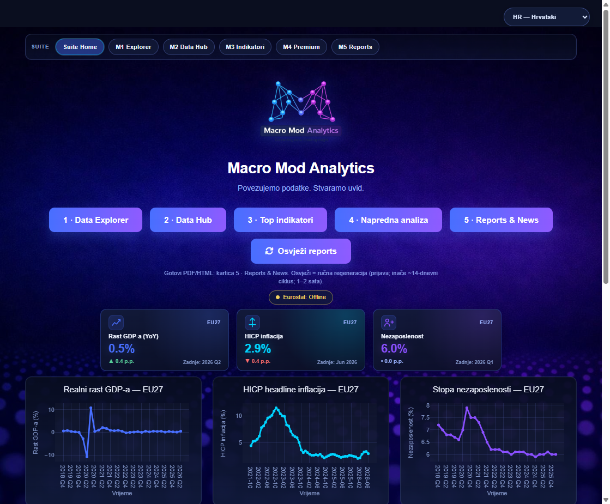
09 · Home · suite landing
Command centre, not analysis
What you see in 10 seconds
SUITE bar — the same 7 buttons (Home + M1–M6) in every module · CTA M1–M6 and Refresh reports · EU27 KPIs: GDP, HICP inflation, unemployment · Source status (Eurostat: Offline / Live)
Macro Mod Analytics · Connecting data. Creating insight. · 9/45
MMA Suite

Slide 10
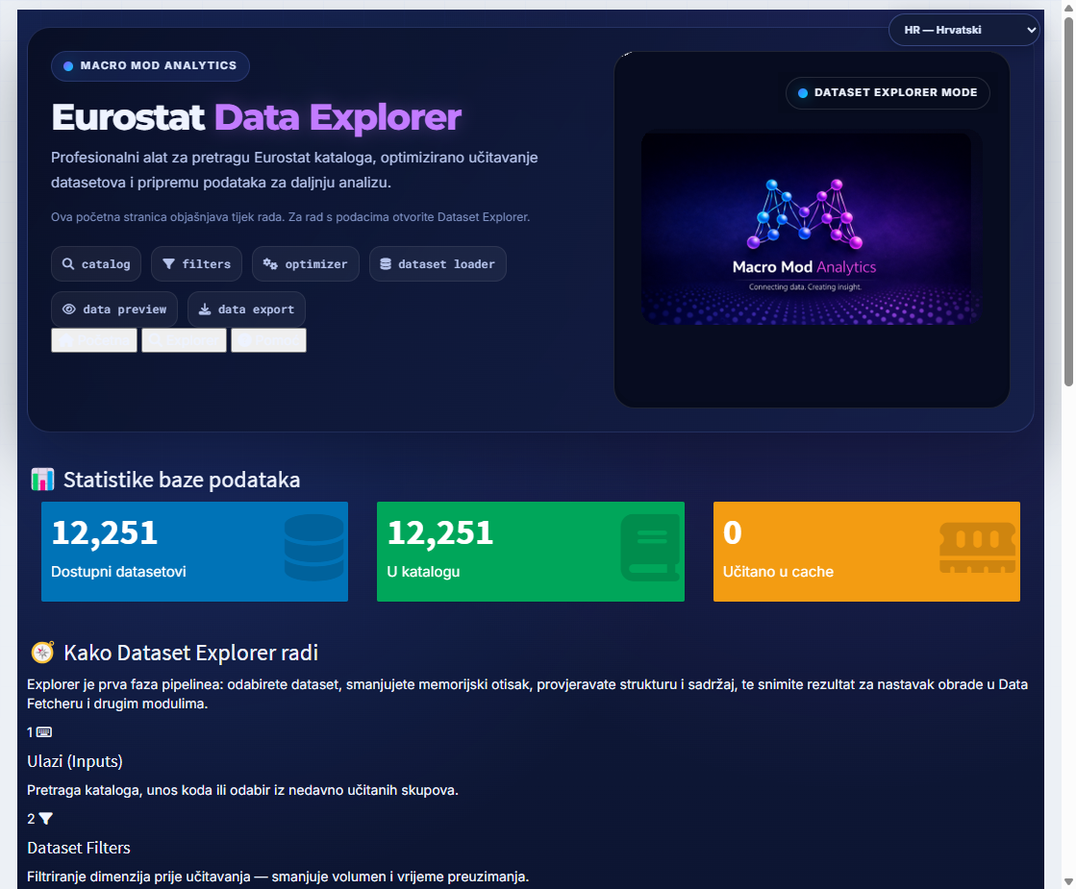
10 · M1 Data Explorer · landing
Optimising the cube before load
Why this is distinctive
A classic Eurostat download pulls too large a cube. M1 forces the filter before the API/cache load — geo, time, frequency.
Macro Mod Analytics · Connecting data. Creating insight. · 10/45
MMA Suite

Slide 11

11 · M2 Data Hub · landing
Tables you can defend
Three doors of the hub
Data Fetcher — dimensions, filters, cache, Final Tables · Pivot Table — drag & drop builder and export · Visualization & Analysis — 5 tools in one workspace
Macro Mod Analytics · Connecting data. Creating insight. · 11/45
MMA Suite

Slide 12
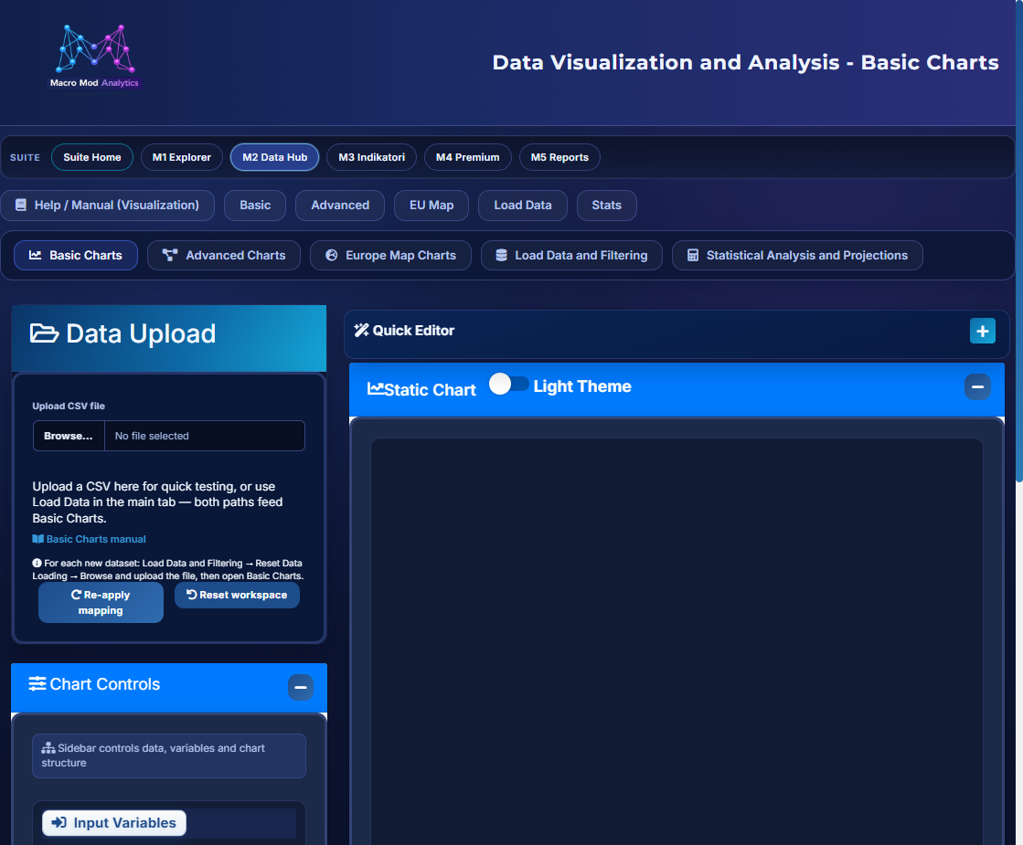
12 · Charts for macro · Visualization & Analysis
From a line to a stock–flow Sankey
Five tools in one workspace
Basic Charts — 10 types (line, bar, stacked, combined, area, scatter, box, histogram, pie/donut/sunburst, step) · Advanced Charts — 8 types (decomposition, Treemap, Sankey, Chord, Variwide, Radar, Dumbbell, Lorenz) · Europe Map Charts · Load Data & Filtering · Statistical Analysis and Projections.
Macro Mod Analytics · Connecting data. Creating insight. · 12/45
MMA Suite

Slide 13
13 · Charts · basic set
The types macro actually asks for
Why these types
Dual axis — the level and the rate are not the same order of magnitude; without a right axis inflation vanishes into the index · Stacked — growth is not a number, it is a sum of contributions; you see at once whether consumption or net exports carry it · Histogram — the average wage can lie; the distribution shows where the mass sits · Two-level pie/sunburst — the aggregate and its accounts in one frame, click to go
Macro Mod Analytics · Connecting data. Creating insight. · 13/45
MMA Suite

Slide 14
14 · Charts · advanced set
Advanced types — for processes, not for pictures
Variwide
A ranking without the cheat: Luxembourg and Germany are not the same “one bar”. Width carries population or GDP, height the per-capita indicator.
Decomposition
STL or classical, additive or multiplicative, frequency 4 / 12 / 52. Separates season from signal before a conclusion about trend.
Chord and Sankey
Sankey for directed flow, Chord for mutual relations (trade, exposures). Both are in Advanced Charts and in the manual.
Time heatmap + the rest
Year × month reveals a seasonal rhythm a line conceals. Plus: Treemap, Radar, Dumbbell, Lorenz. The heatmap here is illustrative only — it is not a catalogue type in Advanced.
Macro Mod Analytics · Connecting data. Creating insight. · 14/45
MMA Suite

Slide 15
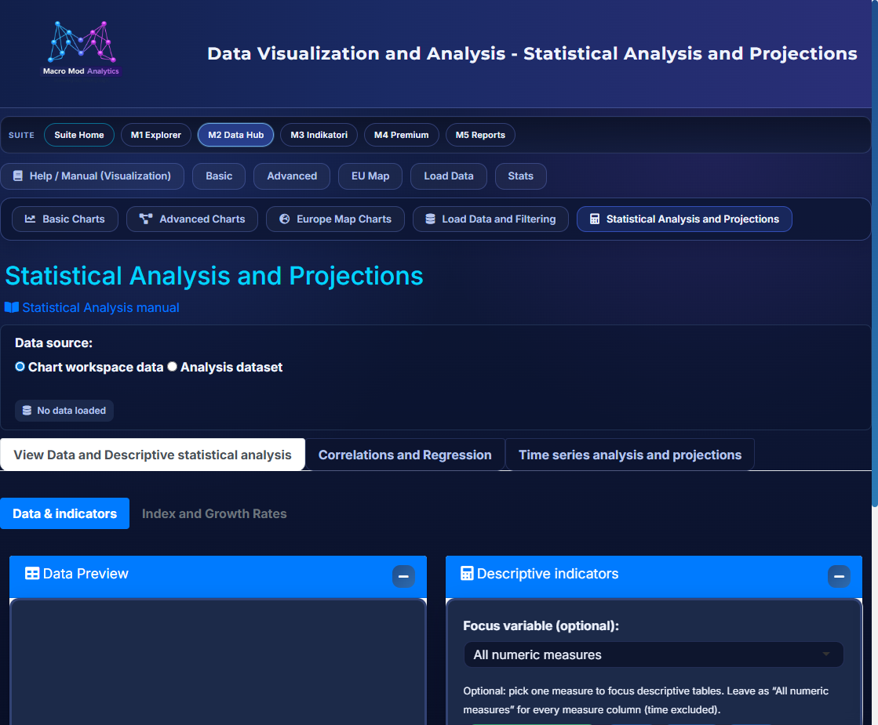
15 · EU map and statistical tools
Europe’s map and statistics in the same workspace
Macro Mod Analytics · Connecting data. Creating insight. · 15/45
MMA Suite

Slide 16
16 · Innovation · smart chart recommendation
The engine ranks the chart type against your table
Load Data & Filtering
After you pick a file, the Chart Examples toggle draws mini-models (small Plotly charts) for recommended types — a % score, TOP PICK, Use chart / Apply Top Pick.
Basic Charts
The same ranking engine: cards with rank, probability 0–100, a reason and an AI insight. No mini chart-models — here it is rank, not preview.
Advanced Charts
The same mechanism for Treemap, Sankey, Chord, decomposition… Apply Top Pick applies the type and mapping. Mini drawings stay on Load Data only.
Macro Mod Analytics · Connecting data. Creating insight. · 16/45
MMA Suite

Slide 17
17 · Live Sankey — pipeline
How value flows through the suite
Interactive: hover the flows. A pedagogical map of the suite, not a MIP assessment.
Macro Mod Analytics · Connecting data. Creating insight. · 17/45
MMA Suite

Slide 18

18 · M3 Top Indicators · landing
Eight sectors + relative EU27=100
What the user chooses
M3 does not give a composite alarm. When you need “is it red?”, you go to M4.
Macro Mod Analytics · Connecting data. Creating insight. · 18/45
MMA Suite

Slide 19
19 · Interactive · M3 sunburst
Click a sector — the indicators open
First level = 8 M3 macro groups (selection subtabs). Second level = series. Click to zoom in, click the centre to return.
Macro Mod Analytics · Connecting data. Creating insight. · 19/45
MMA Suite

Slide 20

20 · M4 Premium Macro · landing
Diagnosis, not another scoreboard
Read-first rule
Semafor is a reading map, not an automatic decision and not a Commission MIP assessment.
Macro Mod Analytics · Connecting data. Creating insight. · 20/45
MMA Suite

Slide 21
21 · Interactive · M4 sunburst
Chapters and tools (workspace subtabs)
First level = analytical blocks. Second = tools the analyst opens as tabs after Run.
Macro Mod Analytics · Connecting data. Creating insight. · 21/45
MMA Suite

Slide 22
22 · Semafor
Red is not a verdict. It is a reading priority.
For a cabinet and a newsroom: “MMA signals tension in …; the detail is in chapter …”.
Red
Tension that deserves an owning chapter: fiscal NGT gap, monetary mismatch, macro-risk board, nowcast pulse. Go there first.
Yellow
Qualifiers: inflation (persistence), labour market, FCI / credit-housing cycle. Rule: do not push yellow into red while you are correcting red.
Green
Not “everything is fine forever”. It is the absence of an alarm in that column — you still read relative M3.
Macro Mod Analytics · Connecting data. Creating insight. · 22/45
MMA Suite

Slide 23

23 · M6 · MADS · landing
MADS DSGE Model — scenarios, not a forecast
What MADS is
A New Keynesian DSGE scaffold (households, firms / Calvo, fiscal, Taylor, external sector) — a DSGE-lite model inside the same suite, calibrated from M3/M4 data.
Macro Mod Analytics · Connecting data. Creating insight. · 23/45
MMA Suite

Slide 24
24 · M6 · model structure
Five blocks and calibration from the suite
Households
Consumption, saving, labour — Euler and labour supply.
Firms / Calvo
Sticky prices, mark-ups, cost pass-through into inflation.
Fiscal
Expenditure, taxes, debt and debt dynamics (NGT layer).
Monetary / Taylor
Interest-rate reaction to inflation and the output gap.
External sector
Exports/imports, competitiveness, CA and NIIP.
Calibration, not invention
M3/M4 data enter the calibration table (pillar). Scenarios and policy-mix timing are tied to the start quarter (start_q), so a shock can be dated, not merely “switched on”.
Macro Mod Analytics · Connecting data. Creating insight. · 24/45
MMA Suite

Slide 25
25 · M6 · interactive · scenarios
Click a shock family — the instruments open
Two kinds: M4-recommended packages (tied to the red Semafor column, MIP and MMA variant) and free / custom what-ifs in the parameter editor.
Macro Mod Analytics · Connecting data. Creating insight. · 25/45
MMA Suite

Slide 26
26 · M6 · result
Δ vs Baseline — Croatia example
Positive
Competitiveness +0.79% GDP; external rebalancing +0.42–0.44%.
Almost neutral
Monetary normalisation +0.11% GDP, but +0.68 p.p. on rates.
Short-run cost
Fiscal debt adjustment −1.69%; composition −0.88%.
Trade-off
Credit de-leveraging: debt −9.47%, but GDP −0.36%.
Macro Mod Analytics · Connecting data. Creating insight. · 26/45
MMA Suite

Slide 27
27 · M6 · limits
What MADS is not — and why that builds trust
Not an official forecast
The banner sits in the UI itself: educational / rough what-if model. No institutional projection, no obligation.
Not a MIP assessment
MIP and MMA package variants exist in parallel, but the imbalance assessment is the Commission’s, not MADS.
Not an institutional recommendation
The result is a Δ path under assumptions the user sees and can change — with AI Insight as a reading aid.
Output from M6
Δ vs Baseline for Y, u, π, CA, debt and NIIP · Scenario Ranking · short MADS report · policy brief M3→M6 · PPTX brief deck.
Why this is an advantage
A serious user does not want a tool that claims too much. They want a tool that says exactly how far it holds — and can then be cited.
Macro Mod Analytics · Connecting data. Creating insight. · 27/45
MMA Suite

Slide 28

28 · Publications · M5 Reports & News
From analysis to an artefact you can send
Macro Mod Analytics · Connecting data. Creating insight. · 28/45
MMA Suite

Slide 29
29 · Demo · 90 seconds
Country X in 90 seconds — from data to a recommendation
Six steps of 15 seconds. The same path an analyst actually walks: input data → ready-made indicators → premium tools → Semafor → scenario test → non-binding recommendations. Example: Croatia, policy brief M3→M6.
Modules the demo touches
What the viewer gets
One diagnosis, one tested response and one document — no manual stitching of sources, no Excel between steps.
What the demo does not promise
Not a forecast and not an institutional assessment. All numbers are an illustrative MADS output for HR, marked as working and non-binding.
Macro Mod Analytics · Connecting data. Creating insight. · 29/45
MMA Suite

Slide 30
30 · Demo · input data
First question: which sample are we even looking at?
What happens in 15 seconds
Select country X and the period — filter before load · Catalogue ~12,251 datasets; only the needed cube is taken · For a standing review: the offline snapshot (RDS/CSV) is already ready · Sources by series: Eurostat, ECB, and for NON-EU a proxy (WB, ONS, FRED)
Macro Mod Analytics · Connecting data. Creating insight. · 30/45
MMA Suite

Slide 31
31 · Demo · M3 Top Indicators
Where country X misses the target
GDP YoY 2.4%
Target > 2.5% — a slowdown, below the reference dynamic.
HICP 3.6%
Target < 2.5% — persistent inflationary pressure.
Unemployment 5.1%
Target < 4.5% — a mild rise versus the previous quarter.
Nowcast pulse −0.37
Target > 0 — a contraction signal for activity.
Macro Mod Analytics · Connecting data. Creating insight. · 31/45
MMA Suite

Slide 32
32 · Demo · M4 premium tools
Why this is happening — the mechanism, not a slogan
Three chapters that open for this case
Fiscal → NGT & vulnerability, debt dynamics, CAB/CAPB: gap 2.54 p.p. · Monetary → Taylor / NGT and transmission: mismatch −4.16 p.p. · Credit / FCI → housing cycle and credit gap: FCI 0.31, housing segment mixed
Macro Mod Analytics · Connecting data. Creating insight. · 32/45
MMA Suite

Slide 33
33 · Demo · Semafor identification
Semafor for country X: three red, three yellow
Red → which scenario
The fiscal gap opens MIP debt adjustment and MMA expenditure composition. The monetary mismatch opens normalisation and a Taylor tilt.
Yellow → what is protected
Inflation, the labour market and FCI are constraints, not the target of the measure. Every tested package is also checked on their direction.
Green → what you build on
A positive competitiveness trend becomes the counterweight to the short-run cost of consolidation.
Macro Mod Analytics · Connecting data. Creating insight. · 33/45
MMA Suite

Slide 34
34 · Demo · answering Semafor through scenarios
M6 MADS: we test a response, we do not guess the future
What is tested for the red fiscal column
Two packages from the M4 recommendation — the MIP variant (debt adjustment) and the MMA variant (expenditure composition). Same model, same horizon, different dose.
Macro Mod Analytics · Connecting data. Creating insight. · 34/45
MMA Suite

Slide 35
35 · Demo · non-binding recommendations for country X
Output: four messages you can send
Prioritise competitiveness
The only package with a clearly positive effect (+0.79% GDP) — structural reforms, productivity, export quality.
Phase fiscal consolidation
Necessary for sustainability, but spread over time and protect investment so the slowdown is not deepened.
Protect financial conditions
Do not loosen FCI too fast; macroprudential monitoring of the housing segment and the credit cycle.
Watch inflation expectations
Alignment of wages and productivity; avoid measures that further strengthen aggregate demand.
Artefacts from the same flow
Comprehensive/sector report, MADS report, policy brief M3→M6 and PPTX brief deck — HR and EN.
Document status
“Working, non-binding summary (MADS)”. That is how it stands in the generated brief — no pretence that it is an official forecast.
Macro Mod Analytics · Connecting data. Creating insight. · 35/45
MMA Suite

Slide 36
36 · Audience · students
From catalogue to a seminar chart in 10 minutes
MMA is not a textbook. It is a laboratory in which you see how a series becomes an argument.
Macro Mod Analytics · Connecting data. Creating insight. · 36/45
MMA Suite

Slide 37
37 · Audience · research
Reproducibility and peer context
Code and cache
Dataset code, filters, Final Table name, offline snapshot — the work can be repeated a week later.
EU27=100
The relative layer prevents a false comparison of absolute rates across different development levels.
Model limits
ARIMA/ETS and MADS are explicitly not an official forecast. A paper cites the tool as diagnostics.
Scenario analysis
MADS calibration and Scenario Ranking give a transparent frame for the robustness of the story.
Macro Mod Analytics · Connecting data. Creating insight. · 37/45
MMA Suite

Slide 38
38 · Audience · media
Newsroom speed, source discipline
A specialised economics desk gets a pack with a disclaimer, not a screenshot without context.
Macro Mod Analytics · Connecting data. Creating insight. · 38/45
MMA Suite

Slide 39
39 · Audience · government
15 minutes to a message — without false authority
Flow for a cabinet / ministry / central bank
The same flow for 34+1 jurisdictions — a comparable language across ministries and central banks.
Macro Mod Analytics · Connecting data. Creating insight. · 39/45
MMA Suite

Slide 40
40 · Other users
Who else benefits
Think-tank / NGO
Compare radar + relative indicators for a peer narrative (V4, CEI, EA).
Consultants
The same pack for 34 countries: fast screening then a deep chapter only where hours are needed.
IFI / donors
USA + EU + candidates in one working language; explicit sources by series.
Operators
START_SUITE, weekly/fortnightly production release, gold QA, LATEST catalogue.
Macro Mod Analytics · Connecting data. Creating insight. · 40/45
MMA Suite

Slide 41
41 · SWOT
MMA’s position among tools
Strengths
The whole chain through to publication, including its own scenario model and smart chart recommendation. 6 UI languages. Reports and manuals in HR and EN. Offline-first. Honest disclaimer. Sankey and Semafor as its own language.
Weaknesses (by design)
Not a tick-by-tick terminal. Not the Commission’s official database. MADS is DSGE-lite, not institutional QUEST. That is a conscious limit, not a bug.
Opportunities
Faculties, newsrooms, cabinets and think-tanks in 34+1 countries that need the same briefing language — without pretending to be Bloomberg or Eurostat.
Threats / substitution
A portal + Excel is still “enough” if the user does not see the value of the narrative. That is why the brief and the deck exist: so the end of the chain is visible.
Macro Mod Analytics · Connecting data. Creating insight. · 41/45
MMA Suite

Slide 42
42 · USP
Why MMA is hard to replace with a portal
One language
From cube filters to Semafor and scenarios — the same countries, the same sources, the same disclaimer.
Diagnosis + artefact
A dashboard that does not produce a PDF/brief remains a screen. MMA finishes with a publication.
Scenario in-house
Few dashboards have their own DSGE-lite layer tied to an alarm from the same system.
Model honesty
Semafor ≠ MIP. MADS ≠ forecast. Relative ≠ absolute.
Smart chart recommendation
Rank 0–100 and TOP PICK from table shape; mini-models on Load Data, rank without drawings in Basic/Advanced.
Macro Mod Analytics · Connecting data. Creating insight. · 42/45
MMA Suite

Slide 43
43 · Documentation
A manual that follows the product
A single user handbook — HR then EN — with original Home and module covers, plus embedded M1–M4 and MADS manuals.
HR
MMA_SUITE_KORISNICKI_MANUAL.html — author’s language, operational detail.
EN
MMA_SUITE_USER_MANUAL_EN.html — for international users, reviewers, partners.
MADS manual
HR and EN version inside M6 — theory, calibration, scenarios.
In-app help
Help tabs and Rmd in the modules; the same theory as in M4 chapter Help.
Macro Mod Analytics · Connecting data. Creating insight. · 43/45
MMA Suite

Slide 44
44 · How to start
The first 30 minutes
Ad-hoc path
M1 HICP or GDP → M2 pivot → Basic or Sankey → export PNG with the source.
Policy path
Do not start from Explorer. Start from the report and Semafor. Explorer is for the question the report did not cover.
Scenario path
Semafor → M6: first an M4-recommended package, then a free what-if, then a MADS report or policy brief.
Macro Mod Analytics · Connecting data. Creating insight. · 44/45
MMA Suite

Slide 45
Call
See country X.
Not just a series.
Macro Mod Analytics — a suite for those who need insight, not another screen of charts. 34+1 countries. 6 languages of control. Home + M1–M6. Manuals and reports in HR and EN.
Macro Mod Analytics · Connecting data. Creating insight. · 45/45
MMA Suite

